Slide 1
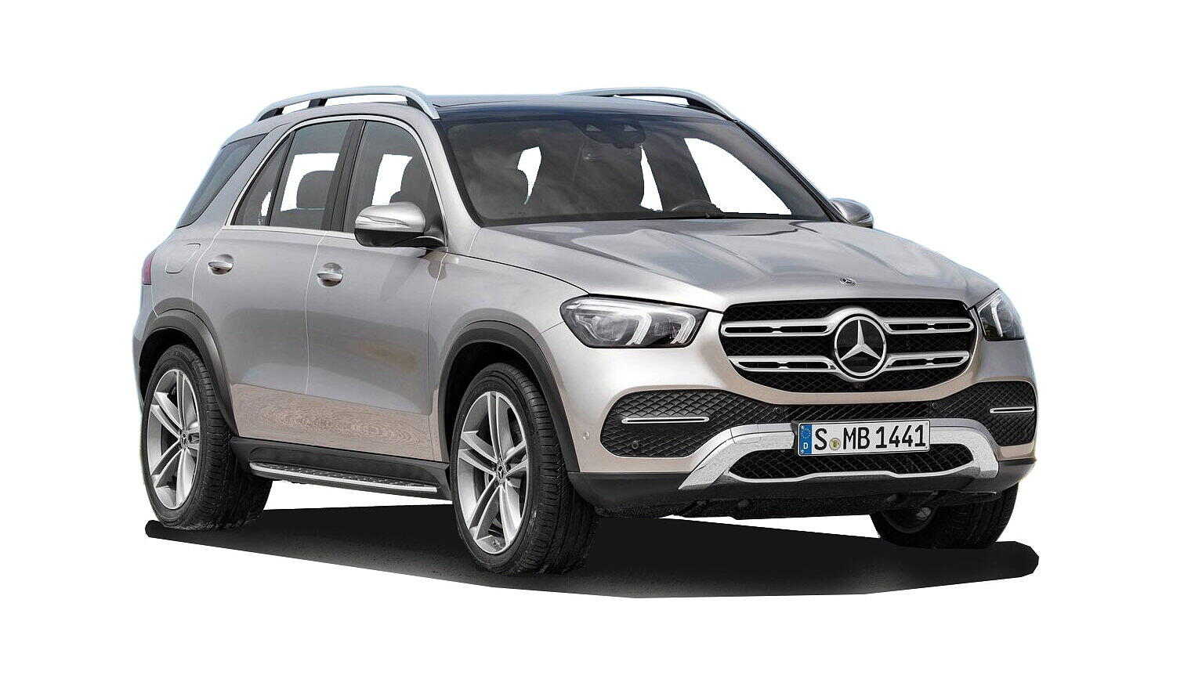


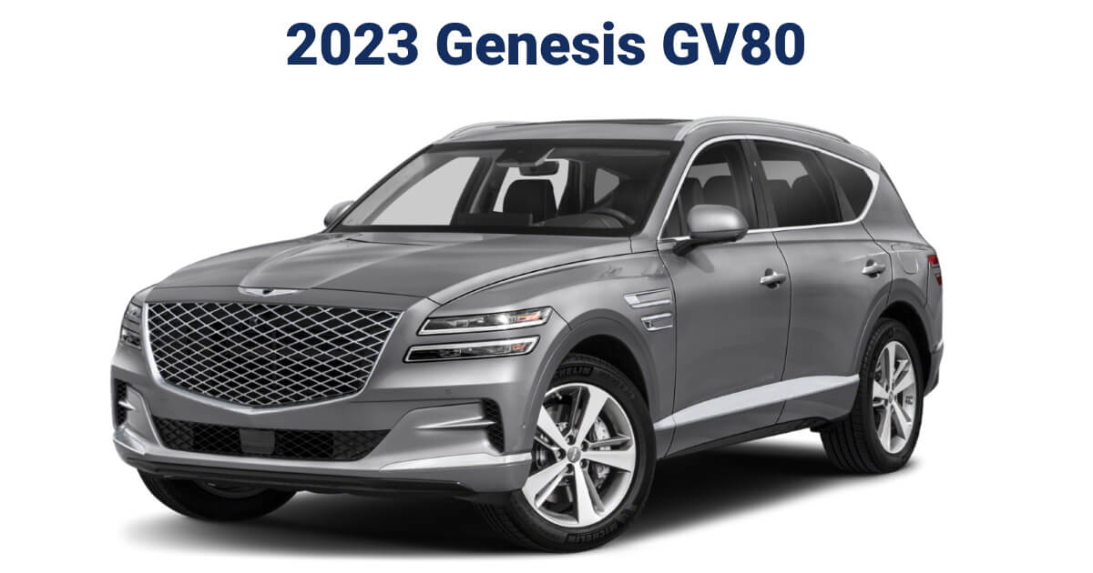
Profiling Model Owners
X5 (BMW), GLE CLASS (Merecedes), GV80 (Genesis), Aviator (Lincoln)

Slide 2

Why People Select Different Make/ Models?
Brand Reputation and Reliability
Performance and Driving Experience
Safety Features
Styling and Design
Fuel Efficiency
Affordability
Personal Preferences (We are going to analyze these)

Slide 3
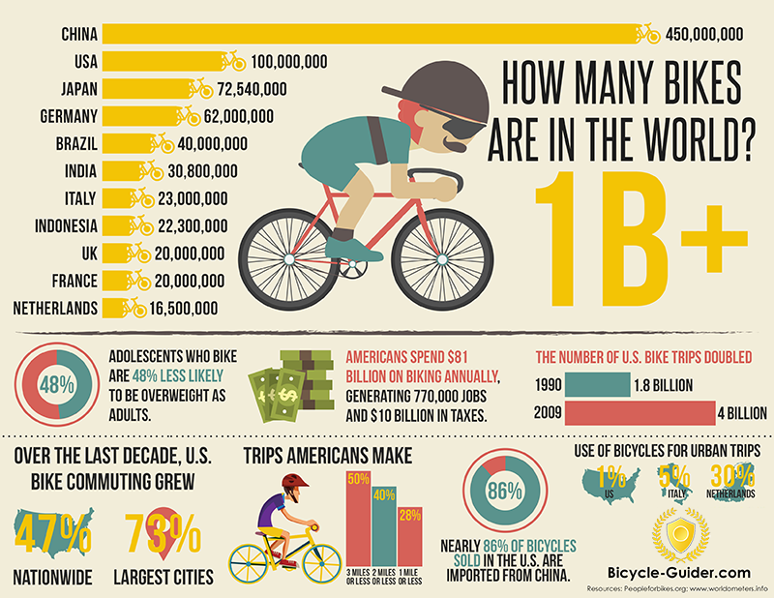
Clustering/ Grouping Based on Demographics
Know Your Customer Strategy
Demographics plays an important role to identify potential customers
This analysis was aim to identify those features which contributes mostly in someone’s choices
We have identified features such as location, gender, salary, children etc.

Slide 4
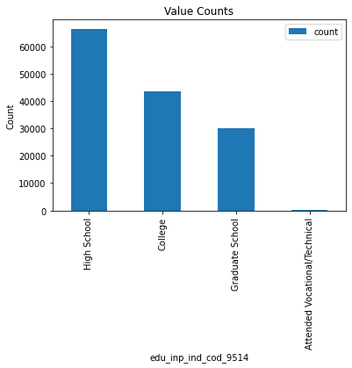
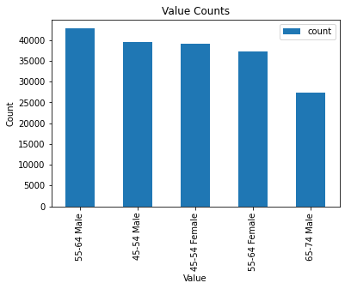
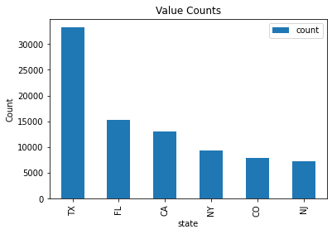
BMW X5 Model
BMW X5 model mostly used by individuals of age bracket 45 to 65 both male and female
Around 20% of the customers belongs to Texas (due to affordability, taxes in TX, lifestyle), then comes Florida
Approx 40% of the BMW X5 owners are High School Graduates (We can say like usually business persons)

Slide 5
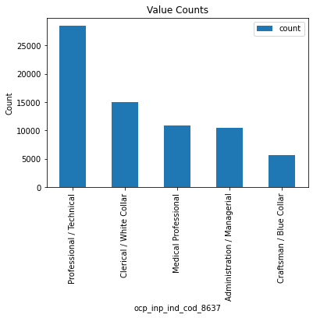
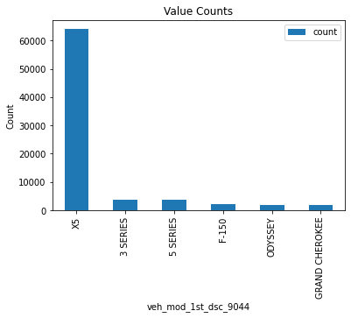
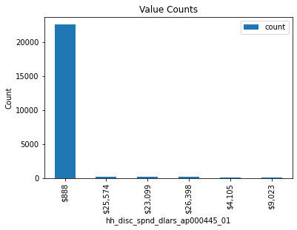
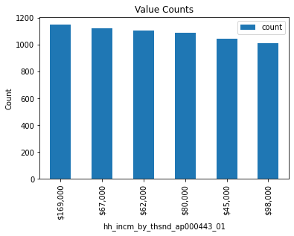
BMW X5 Model
Almost 40% of the owners have same model previously - this shows the quality of product and other features
Over 25% of the owners are professional/ technical/ white collar jobs holders - shows the affordability
People having salary greater than 50K usually afford this model
They are LESS SPENDERS

Slide 6
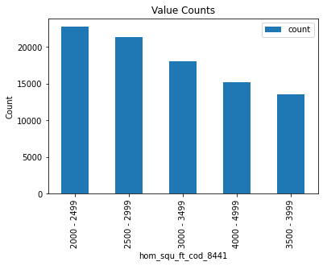
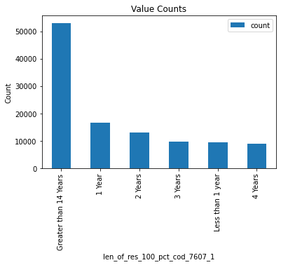
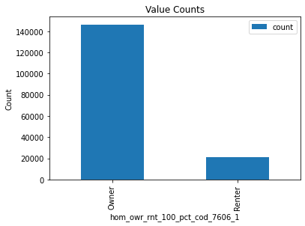
BMW X5 Model
Home Owners (not renters) having X5 model make 88% of customer base
Long lasting owners - people who changes home seldom are X5 lovers (over 32% are such customers)
Medium sized home (2K to 4K Sq Ft) owners own X5 models - they spent behavior is EQUAL - spent medium on each thing

Slide 7
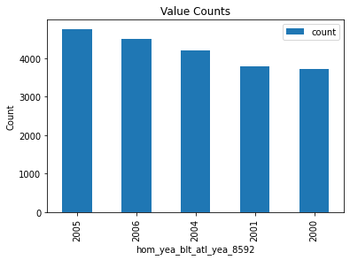
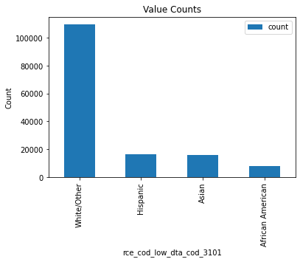
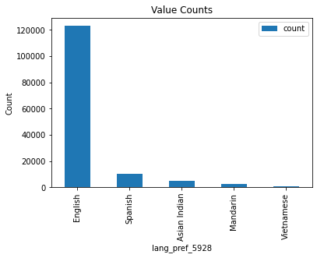
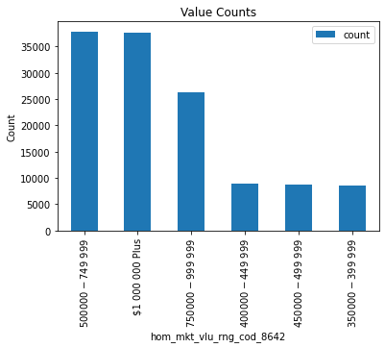
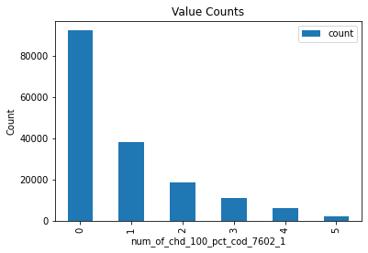
BMW X5 Model
Old houses - in past the construction was cheap - such people might have SAVINGS behavior
Market value of houses range from 500K to 1000K
74% of X5 owners are English and around 8% are spanish
These owners have small number of children usually either No or 1 or 2
Race wise mostly White people

Slide 8
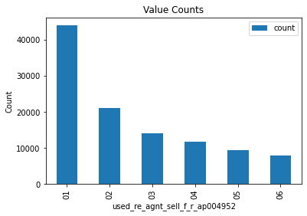
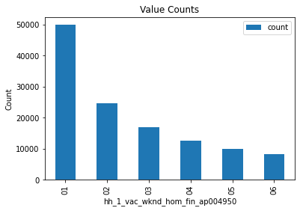
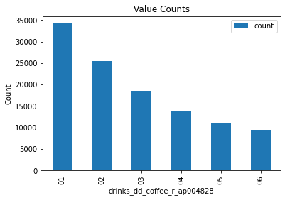
BMW X5 Model
Drinks very small amount of Coffee :) - Save money - SAVERS
Used_re_agnt_f_r
hh_1_vac_wknd_hom_fin

Slide 9

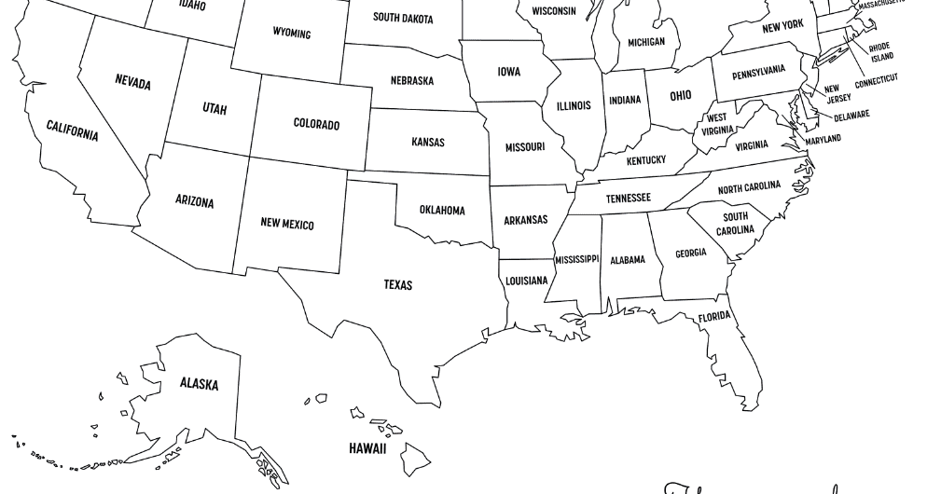



BMW X5 Model - Owner Persona
Home Ownership: 88% homeowners
Home Type: Medium-sized (2K-4K Sq Ft)
Housing Market Value: $500K-$1,000K
Age: 45-65
Gender: Male and female
Family Size: Usually no or 1-2 children
Race: Predominantly white
Education: 40% High School Graduates (business persons)
Occupation: 25% professionals/white-collar jobs
Ethnicity: 74% English, 8% Spanish
Salary: >$50,000
Spending Habits: Less spenders, moderate spending
Coffee Consumption: Very minimal
Savings Behavior: Prudent and frugal

Slide 10
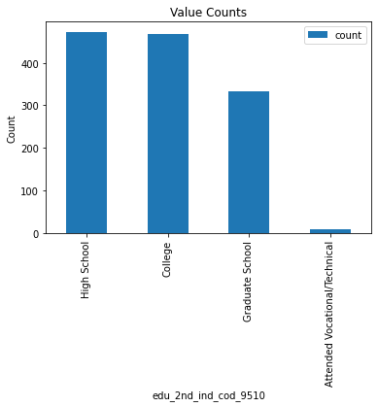
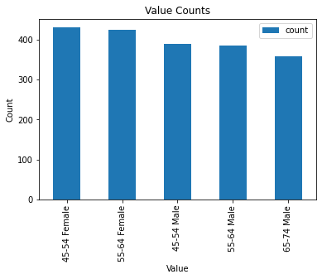
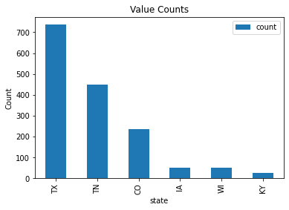
GV80 Model - Genesis
GV80 model mostly used by individuals of age bracket 45 to 75 both male and female (preferably by female)
Around 43% of the customers belongs to Texas (due to affordability, taxes in TX, lifestyle), then Tennessee (26%)
Approx 27% of the GV80 owners are High School Graduates

Slide 11
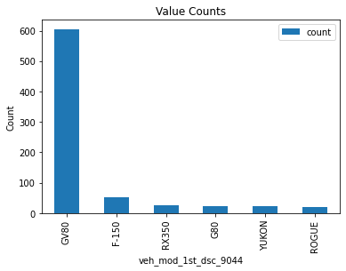
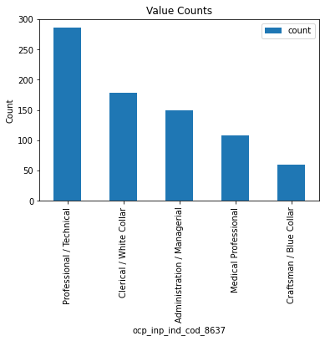
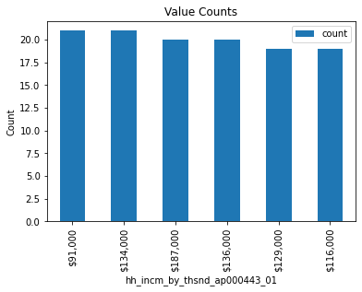
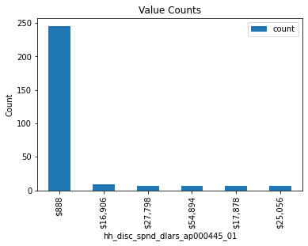
GV80 Model - Genesis
Almost 35% of the owners have same model previously - this shows the quality of product and other features
Over 27% of the owners are professional/ technical/ white collar jobs holders - shows the affordability
People having salary greater than 90K usually afford this model
They are VERY LESS SPENDERS

Slide 12
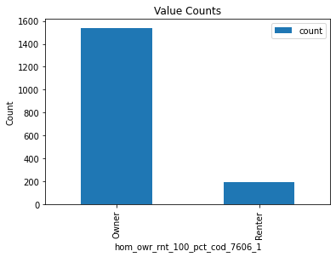
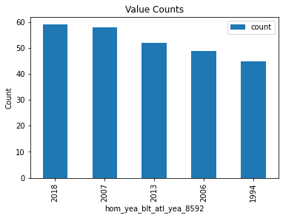
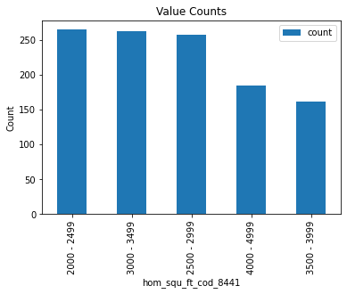
GV80 Model - Genesis
Home Owners (not renters) having GV80 model make 89% of customer base (similar to X5)
House age does not matter for GV80 owners - contains old as well new houses
Around 55% customers have medium/large sized home (2K to 5K Sq Ft)

Slide 13
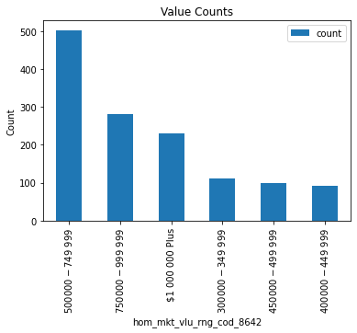
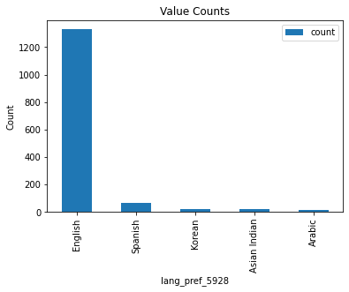
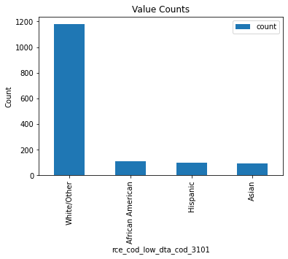
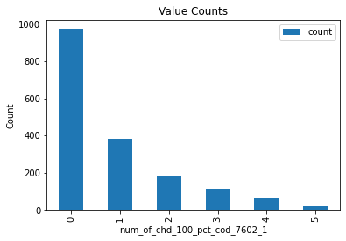
GV80 Model - Genesis
Market value of houses range from 500K to 750K (less costly houses as compared to X5 owners)
77% of GV80 owners are English and around 4% are Spanish
These owners (around 57%) don't have any children
Race wise mostly White people and then African Americans

Slide 14
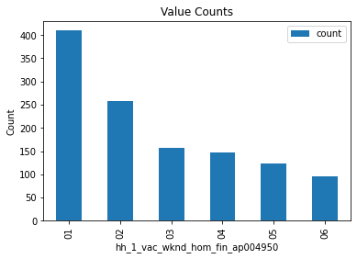
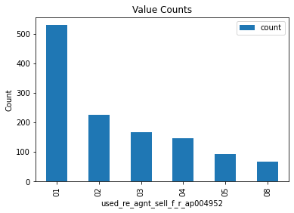
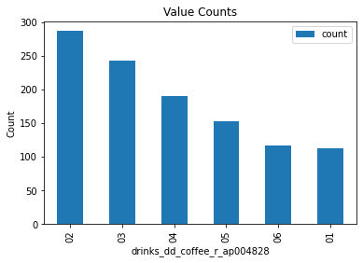
GV80 Model - Genesis
Drinks coffee more than X5
Used_re_agnt_f_r
hh_1_vac_wknd_hom_fin

Slide 15
Genesis GV80 Model - Owner Persona
Home Ownership: 89% homeowners
Home Size: Medium to large sized (2K-5K Sq Ft)
Housing Market Value: $500K-$750K
Age: 45-75 (predominantly females)
Gender: Male and female
Family Size: Usually Single
Race: Mostly white
Education: 45% High School Graduates
Occupation: 27% professionals/technical/ white-collar jobs
Ethnicity: 77% English, 4% Spanish
Salary: >$90,000
Spending Habits: Very less spenders, Frugal
Coffee Consumption: More often
Savings Behavior: Prudent and Cost Conscious

Slide 16
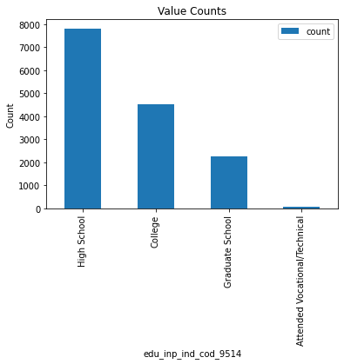
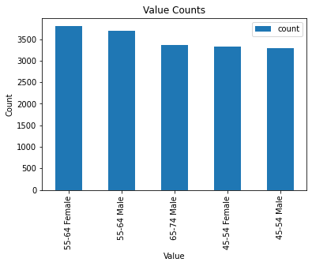
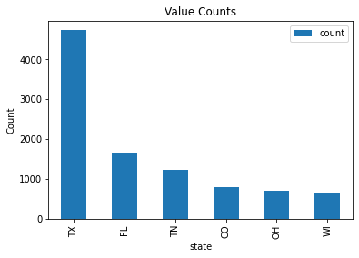
Aviator Model - Lincoln
Aviator model mostly used by individuals of age bracket 45 to 75 both male and female
Around 27% of the customers belongs to Texas and small proportion from other states such as Florida and Tennessee
Approx 44% of the Aviator owners are High School Graduates

Slide 17
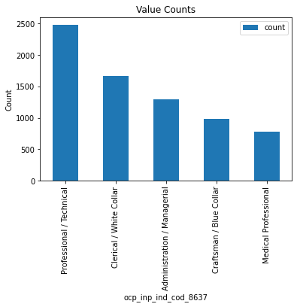
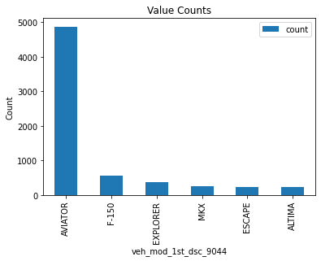
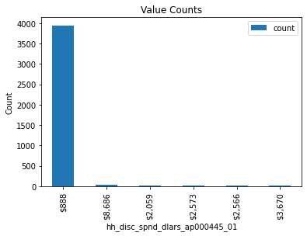
Aviator Model - Lincoln
Almost 28% of the owners have same model previously - this shows the quality of product and other features
Over 27% of the owners are professional/ technical/ white collar jobs holders - Management people also interested in this model
People having salary greater than 30K usually afford this model
They are Lowest Spenders as compared to X5 and GV80

Slide 18
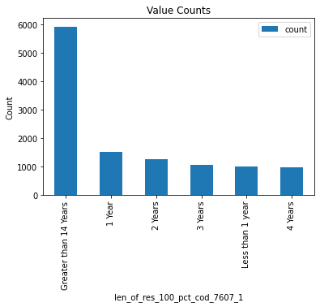
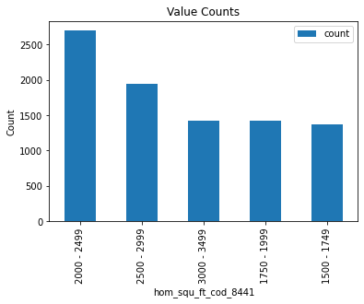
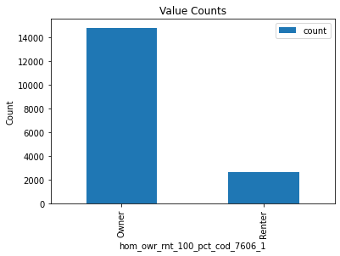
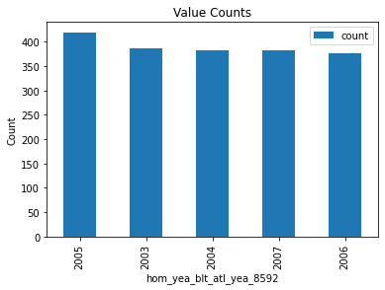
Aviator Model - Lincoln
Home Owners (not renters) having Aviator model make 85% of customer base (similar to X5 and GV80)
Aviator owners have old/ aged houses
People with minimum movements from one place to another own this model
Aviator owners owns small size houses (< 3K Sq Ft)

Slide 19
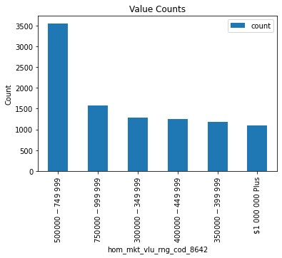



Aviator Model - Lincoln
Market value of houses range up to 500K (less costly houses as compared to X5 and GV80 owners)
80% of Aviator owners are English and around 10% are Spanish (greater as compared to GV80 and X5)
These owners are mostly single/ unmarried
Race wise mostly White people and then Hispanic (11%)

Slide 20



Aviator Model - Lincoln
Drinks coffee more than X5
Used_re_agnt_f_r
hh_1_vac_wknd_hom_fin

Slide 21
Lincoln Aviator Model - Owner Persona
Home Ownership: 85% homeowners
Home Type: Usually old/ aged house
Home Size: Medium to large sized (< 3K Sq Ft)
Housing Market Value: Up to $500K
Minimum Reallocation
Age: 45-75
Gender: Male and female
Family Size: Usually Single
Race: Mostly white followed by Hispanic (11%)
Education: 44% High School Graduates
Occupation: 27% professionals/technical/ white-collar jobs and management positions
Ethnicity: 80% English, 10% Spanish (High as compared to Others)
Salary: >$30,000
Spending Habits: Lowest Spenders amongst all
Coffee Consumption: More often
Savings Behavior: Financially Conservative and Cost Conscious

Slide 22



GLE Class - Mercedes
GLE model mostly used by individuals of age bracket 45 to 75 both male and female
Around 45% of the customers belongs to Florida, than Texas (10%)
Approx 34% of the GLE owners are College students - These are people who left studies due to business or other reason

Slide 23




GLE Class - Mercedes
Maximum such owners previously owned some other models of Mercedes
Owners belongs to profession like Technical, Management, Medical, White Collar etc.
People having salaries in range 70K to 150K
They are HIGH SPENDERS

Slide 24



GLE Class - Mercedes
Home Owners (not renters) having GLE model make 93% of customer base
Most of the customers have reallocated recently
Most of the customers have Small-medium sized home (2K to 4K Sq Ft)

Slide 25




GLE Class - Mercedes
Market value of houses range from 300K to 1000K+ (extreme values)
67% of GLE owners are English and around 13% are spanish - Mostly have Hispanic as their country of origin
These owners (around 90%) have either no children or less than 3
Race wise mostly White people and then Hispanic

Slide 26



GLE Class - Mercedes
Drinks coffee more than everyone else
Used_re_agnt_f_r
hh_1_vac_wknd_hom_fin

Slide 27
Mercedes GLE Model - Owner Persona
Home Ownership: 93% homeowners
Home Size: Small to Medium sized (2K-4K Sq Ft)
Housing Market Value: $300K-$1000K
Recent reallocation
Age: 45-75
Gender: Male and female
Family Size: No kids or < 3
Race: Mostly white, followed by Hispanic
Education: 34% College Students (Left Studies)
Occupation: Professionals/technical/ Medical/ white-collar jobs
Ethnicity: 67% English, 13% Spanish (mostly Hispanic origin)
Salary: $70,000 - $150,000
Spending Habits: High Spenders
Coffee Consumption: Higher than all
Savings Behavior: Moderate Saving Behavior

Slide 28
BWM X5 Owners Persona
The BMW X5 attracts individuals aged 45 to 65, both male and female. The majority of owners in this cluster belong to Texas, followed by Florida. They are typically high school graduates, often working in professional or technical fields. Owners have a previous history of owning the same model, indicating satisfaction with the product. With their professional roles, they have an affinity for quality and luxury. These owners have medium to high incomes, and their spending habits are moderate. They are likely to be homeowners, preferring medium-sized homes (2K to 4K Sq Ft) with market values ranging from 500K to 1000K. They are predominantly English-speaking, often white, and have a small number of children. Coffee consumption is minimal, indicating a preference for savings.

Slide 29
Genesis GV80 Owners Persona
The Genesis GV80 appeals to individuals aged 45 to 75, both male and female, with a slightly higher preference among females. The largest customer base is in Texas, followed by Tennessee. Owners in this cluster have a diverse educational background, but a significant proportion are high school graduates. Like the BMW X5 cluster, GV80 owners have a history of owning the same model, indicating brand loyalty. They are professionals, holding technical or white-collar jobs, and have higher incomes (typically above 90K). GV80 owners are known for their conservative spending habits and a preference for homeownership. They tend to have medium to large-sized homes (2K to 5K Sq Ft) with market values ranging from 500K to 750K. The majority are English-speaking, primarily white, and have either no children or a small number of children. Coffee consumption is higher than the X5 owners, but still moderate.

Slide 30
Lincoln Aviator Owners Persona
The Lincoln Aviator attracts individuals aged 45 to 75, both male and female, with a preference among males. The primary customer base is in Texas, with smaller proportions from other states such as Florida and Tennessee. Owners in this cluster typically have a high school education and show a significant interest in the Aviator model. They hold professional, technical, or white-collar jobs, reflecting their management positions and affluence. Their income level is lower compared to the X5 and GV80 clusters, typically around 30K. Aviator owners are known for their conservative spending habits and a preference for homeownership. They tend to have aged houses, and their home sizes are relatively smaller (< 3K Sq Ft) with market values up to 500K. The majority are English-speaking, primarily white, with a significant Hispanic minority. Most owners are single or unmarried, and coffee consumption is higher than X5 owners

Slide 31
Mercedes GLE Owners Persona
The Mercedes GLE Class appeals to individuals aged 45 to 75, both male and female, with a preference among females. The largest customer base is in Florida, followed by Texas. Owners in this cluster have a diverse educational background, with a significant proportion being college students who left studies for business or other reasons. They often have prior ownership experience with different Mercedes models, indicating brand loyalty. GLE owners are professionals in various fields, with higher incomes ranging from 70K to 150K. They are known for their high spending habits and a preference for homeownership. They tend to have recently relocated and own small to medium-sized homes (2K to 4K Sq Ft) with varying market values, ranging from 300K to 1,000K+. The majority are English-speaking, primarily white, with a significant Hispanic minority. GLE owners usually have no children or fewer children.

Slide 32
Clustering/ Grouping

Slide 33
Similarities
Owners of all models have a significant presence in Texas, Florida and Tennessee.
A considerable portion of owners in all model are high school graduates except Mercedes GLE model, who are college passed out.
Owners are mostly professional, technical, and white-collar jobs for all models.
A majority of owners in all models prefer homeownership rather than renting.
Market value of houses ranges up to 1000K in all models.
The majority of owners of all models are English-speaking, with a significant presence of white individuals.

Slide 34
Conclusion – Similarities
BMW X5 and Lincoln Aviator share similarities in terms of age bracket, geographic distribution (with a focus on Texas), educational background, brand loyalty, professional backgrounds, and affordability.
BMW X5 and Mercedes GLE Class show similarities in geographic distribution (with a focus on Florida), homeownership preference, market value of houses, language preferences, and coffee consumption habits.
Lincoln Aviator and Mercedes GLE Class have similarities in terms of professional backgrounds, homeownership preference, language preferences, and coffee consumption habits.

Slide 35
Conclusion – Implications
Understanding these personas and their preferences can help automotive manufacturers and marketers tailor their strategies to attract and retain customers.
Geographic targeting, affordability, quality, and features are essential factors to consider when promoting these models.
By focusing on the commonalities shared by these clusters, companies can develop effective marketing campaigns and enhance customer satisfaction.

Slide 36
Conclusion – Future Work
Further research can explore additional factors influencing model preferences, such as lifestyle choices, vehicle features, and customer feedback.
Analyzing customer reviews and feedback can provide insights into specific aspects of each model that resonate with their respective clusters.
Continuously monitoring and adapting marketing strategies based on changing customer preferences and market dynamics will be crucial for sustained success.

Slide 37
Final Comments
Lincoln Aviator:
Targeting buyers seeking refined luxury, comfort, and elegance.
Popular among suburban and rural areas.
Attracts professionals, executives, and individuals in various industries.
Purchased by individuals with a moderate to high income range.
Focuses on a smooth and quiet ride, advanced safety features, and interior comfort.
Suitable for families with a moderate number of children.
Buyers who prioritize a comfortable and relaxed driving experience.
Mercedes GLE Class:
Targeting buyers who seek a combination of luxury, performance, and versatility.
Popular in upscale urban and suburban areas.
Attracts professionals, executives, and individuals in managerial roles.
Purchased by individuals with a moderate to high income range.
Focuses on cutting-edge technology, premium materials, and a comfortable driving experience.
Suitable for families with varying sizes, including those with multiple children.
Buyers who value status, innovative features, and a blend of performance and luxury.
Genesis GV80:
Appealing to those who prioritize luxury, comfort, and modern features.
Popular in affluent areas and metropolitan cities.
Attracts professionals, executives, and business owners.
Purchased by individuals with a higher income range.
Emphasizes advanced technology, safety, and a spacious interior.
Attracts buyers with small families or empty nesters.
Buyers who value a smooth and comfortable driving experience.
BMW X5:
Known for its sporty and luxurious image, appealing to those with an active lifestyle.
Popular among urban and suburban dwellers.
Attracts professionals, entrepreneurs, and those in managerial positions.
Purchased by individuals with a moderate to high income range.
Balances performance, comfort, and style, with a focus on driving dynamics.
Suitable for families with a moderate number of children.
Buyers who value brand reputation, driving pleasure, and versatility.

Slide 38



Age Group Clustering 18 – 24 Male
`
This age group belongs to; 16% from TX, 10% from FL, 6% from NY, 6% from CO, 5% from MA, 5% from OH and rest from other states.
This age group mostly are High School students (59% of overall users), then 25% are college students.
Around 91% of these people are using BMW, then 8% using Lincoln and very small portion using other MAKEs.
91% of this age group using X5 – BMW model

Slide 39




Age Group Clustering 18 – 24 Male
Approx. 30% of this age group are PROFESSIONAL/ TECHNICAL, 15% are WHITE COLOR JOB people.
Salary range of this group is over $80,000
90% of these age group people are OWNER of Homes/ houses (only 10% renters).
Over 60% of these age group peoples’ house market values is greater than $500,000.

Slide 40





Age Group Clustering 18 – 24 Male
Over 37% of these people living in their houses/ homes for last 15+ years.
Over 45% of these peoples’ houses are from 2000 Sq ft to 3500 Sq ft.
Over 20% of this age group have houses built 20 years ago.
Over 75% of these people are WHITE/OTHER and 11% are Hispanic.
Over 36% of these people have no child.

Slide 41
Age Group Clustering 18 – 24 Male – Profile
Geographic Distribution: This age group of business people is distributed across various states in the United States. Around 16% of them are located in Texas (TX), 10% in Florida (FL), 6% in New York (NY), 6% in Colorado (CO), 5% in Massachusetts (MA), 5% in Ohio (OH), and the rest are from other states.
Education and Occupation: While some individuals in this age group may still be in high school or college, a significant portion of them have already entered the business world. Many are aspiring entrepreneurs, startup founders, or young professionals aiming to establish their careers in the business domain.
Preferred Car Make and Model: When it comes to their choice of vehicles, this group predominantly prefers luxury car brands. Approximately 91% of these business people use BMW cars, demonstrating their affinity for high-quality and prestigious automobiles.
Income and Financial Status: Given their involvement in business, these individuals often enjoy a higher income level. Their average salary range is over $80,000, reflecting their economic stability and potential for financial growth.

Slide 42
Age Group Clustering 18 – 24 Male – Profile
Housing and Property Ownership: A notable characteristic of this age group is their inclination towards property ownership. Over 90% of these business people are homeowners, showcasing their investment in real estate and desire for long-term stability. They take pride in owning their homes rather than renting.
Home Market Value and Size: Their houses typically have a substantial market value, with over 60% exceeding $500,000. In terms of size, approximately 45% of their homes range from 2000 square feet to 3500 square feet, providing them with ample space for comfortable living and potential home offices or workspaces.
Residential Stability: These business-minded individuals tend to establish long-term roots. Over 37% of them have been living in their current houses for 15 years or more, indicating their commitment to stability and a desire for a familiar environment.
Ethnicity: In terms of ethnicity, around 75% of business people in this age group identify as white or belong to other ethnic groups, while approximately 11% are Hispanic.
Family Status: The majority of individuals in this age group have not yet started families, as over 36% of them do not have children. This is likely due to their focus on establishing their careers and pursuing business opportunities.

Slide 43


Age Group Clustering 18 – 24 Female
`
This age group belongs to; 17% from TX, 9% from FL, 7% from NY, 6% from CA, 5% from CO, 5% from MA and rest from other states.
This age group mostly are High School students (60% of overall users), then 25% are college students.
Around 91% of these people are using BMW, then 8% using Lincoln and very small portion using other MAKEs.
91% of this age group using X5 – BMW model

Slide 44




Age Group Clustering 18 – 24 Female
Approx. 30% of this age group are PROFESSIONAL/ TECHNICAL, 15% are WHITE COLOR JOB people.
Salary range of this group is over $60,000 (lower as compared to male).
90% of these age group people are OWNER of Homes/ houses (only 10% renters).
Over 60% of these age group peoples’ house market values is greater than $500,000.

Slide 45





Age Group Clustering 18 – 24 Female
Over 39% of these people living in their houses/ homes for last 15+ years.
Over 45% of these peoples’ houses are from 2000 Sq ft to 3500 Sq ft.
Over 20% of this age group have houses built 20 years ago.
Over 73% of these people are WHITE/OTHER and 12% are Hispanic.
Over 36% of these people have no child.

Slide 46
Age Group Clustering 18 – 24 Female – Profile
Geographic Distribution: This age group of business people is distributed across various states in the United States. Approximately 17% of them are located in Texas (TX), 9% in Florida (FL), 7% in New York (NY), 6% in California (CA), 5% in Colorado (CO), 5% in Massachusetts (MA), and the rest are from other states.
Education and Occupation: The majority of individuals in this age group are high school students, accounting for approximately 60% of the overall users. Around 25% are college students, indicating their pursuit of higher education to support their business aspirations.
Preferred Car Make and Model: Similar to their male counterparts, the female business people in this age group show a preference for luxury car brands. Approximately 91% of them use BMW cars, with the X5 model being the most popular choice. Additionally, 8% of this group prefer Lincoln vehicles, while a smaller portion opt for other car makes.
Income and Financial Status: While these business-oriented females have entered the workforce, their average salary range is slightly lower than their male counterparts. Their income typically exceeds $60,000, which still showcases their economic stability and potential for financial growth.

Slide 47
Age Group Clustering 18 – 24 Female – Profile
Housing and Property Ownership: Similar to the male business people, approximately 90% of females in this age group are homeowners, demonstrating their inclination towards property ownership and long-term stability. Only 10% prefer renting.
Home Market Value and Size: The houses owned by these individuals typically have a substantial market value, with over 60% exceeding $500,000. In terms of size, approximately 45% of their houses range from 2000 square feet to 3500 square feet, providing ample space for comfortable living and potential home offices or workspaces.
Residential Stability: These business-oriented females prioritize stability, as over 39% of them have been living in their current houses for 15 years or more, showcasing their commitment to a familiar environment.
Ethnicity: In terms of ethnicity, over 73% of business people in this age group identify as white or belonging to other ethnic groups, while approximately 12% are Hispanic.
Family Status: Similar to their male counterparts, over 36% of females in this age group do not have children, likely due to their focus on establishing their careers and pursuing business opportunities.

Slide 48









Age Group Clustering 25 – 34 Male
Over 23% belongs to TX, 8% from FL, 7% from CO, 6% from CA, 6% from NY, 5% from TN and rest from other states.
Over 90% are using BMW (X5) bike.
85% of this group own houses.
Over 32% of these people living in their houses/ homes for last 15+ years.
Over 32% of these peoples’ houses are from 2000 Sq ft to 3000 Sq ft.
Over 20% of this age group have houses built 20 years ago.
House market value of these houses (for 23% people) is from $500,000 to $750,000.
30% people are professional/ technical, while 15% are white collar/ clerical staff.

Slide 49
Age Group Clustering 25 – 34 Male – Profile
Geographic Distribution: This age group of business people is distributed across various states in the United States. Approximately 23% of them belong to Texas (TX), 8% are from Florida (FL), 7% from Colorado (CO), 6% from California (CA), 6% from New York (NY), 5% from Tennessee (TN), and the rest are from other states.
Preferred Car Make and Model: The majority of individuals in this age group, over 90%, use BMW bikes, with the X5 model being the most popular choice. This preference indicates their affinity for high-quality and prestigious motorcycles.
Housing and Property Ownership: Approximately 85% of these male business people own houses, showcasing their inclination towards property ownership and long-term stability.
Residential Stability: A significant portion, over 32%, of individuals in this age group have been living in their current houses for 15 years or more, highlighting their commitment to a familiar environment.
Home Size and Age: Around 32% of their houses range from 2000 square feet to 3000 square feet, providing ample space for comfortable living and potential home offices or workspaces. Moreover, approximately 20% of this age group have houses that were built 20 years ago, indicating a preference for established properties.
House Market Value: For 23% of individuals in this group, their houses' market value falls within the range of $500,000 to $750,000. This demonstrates their investment in properties of substantial worth.
Occupation: Approximately 30% of individuals in this age group are engaged in professional/technical roles, indicating their expertise and involvement in specialized fields. Additionally, around 15% of them work in white-collar or clerical positions.

Slide 50









Age Group Clustering 45 – 54 Male
Over 19% belongs to TX, 9% from FL, 7% from CA, 5% from NY, 5% from NJ, 5% from CO and rest from other states.
Over 90% are using BMW (X5) bike.
Over 90% of this group own houses.
Over 26% of these people living in their houses/ homes for last 15+ years.
Over 30% of these peoples’ houses are from 2000 Sq ft to 3000 Sq ft.
Over 17% of this age group have houses built 20 years ago.
House market value of these houses (for 24% people) is from $1,000,000+.
30% people are professional/ technical, while 15% are white collar/ clerical staff.

Slide 51



Age Group Clustering 45 – 54 Male
72% are White/ Other and 11% are Asian.
Income starts with $62,000.
66% of these people have no kids.

Slide 52
Age Group Clustering 45 – 54 Male – Profile
Geographic Distribution: This age group of business people is distributed across various states in the United States. Approximately 19% of them belong to Texas (TX), 9% are from Florida (FL), 7% from California (CA), 5% from New York (NY), 5% from New Jersey (NJ), 5% from Colorado (CO), and the rest are from other states.
Preferred Car Make and Model: The majority of individuals in this age group, over 90%, use BMW bikes, with the X5 model being the most popular choice. This preference demonstrates their affinity for high-quality and prestigious motorcycles.
Housing and Property Ownership: Over 90% of these male business people own houses, showcasing their inclination towards property ownership and long-term stability.
Residential Stability: A significant portion, over 26%, of individuals in this age group have been living in their current houses for 15 years or more, indicating their commitment to a familiar and established environment.
Home Size and Age: Approximately 30% of their houses range from 2000 square feet to 3000 square feet, providing ample space for comfortable living and potential home offices or workspaces. Moreover, around 17% of this age group have houses that were built 20 years ago, indicating a preference for more mature properties.
House Market Value: For 24% of individuals in this group, their houses have a market value of $1,000,000 or more, reflecting their investment in high-value properties.
Occupation: Approximately 30% of individuals in this age group are engaged in professional/technical roles, indicating their expertise and involvement in specialized fields. Additionally, around 15% of them work in white-collar or clerical positions.
Ethnicity: In terms of ethnicity, approximately 72% of individuals in this age group identify as white or belonging to other ethnic groups, while approximately 11% are Asian.
Income: The income range for this group starts at $62,000, indicating a stable financial status and potential for higher earnings.
Family Status: A significant proportion, approximately 66%, of individuals in this age group do not have children. This suggests a focus on their careers and personal pursuits.

Slide 53








Age Group Clustering 45 – 54 Female
Over 19% belongs to TX, 9% from FL, 7% from CA, 5% from NY, 5% from NJ, 5% from CO and rest from other states.
Over 90% are using BMW (X5) bike.
Over 91% of this group own houses.
Over 30% of these people living in their houses/ homes for last 15+ years.
Over 31% of these peoples’ houses are from 2000 Sq ft to 3000 Sq ft.
Over 17% of this age group have houses built 20 years ago.
House market value of these houses (for 27% people) is from $500,000 to $1,000,000+.
29% people are professional/ technical, while 17% are white collar/ clerical staff.

Slide 54



Age Group Clustering 45 – 54 Female
48% of the individuals are High School Graduates.
42% of these people have no kids.
Income starts with $62,000.

Slide 55
Age Group Clustering 45 – 54 Female – Profile
Geographic Distribution: This age group of business people is distributed across various states in the United States. Approximately 19% of them belong to Texas (TX), 9% are from Florida (FL), 7% from California (CA), 5% from New York (NY), 5% from New Jersey (NJ), 5% from Colorado (CO), and the rest are from other states.
Preferred Car Make and Model: The majority of individuals in this age group, over 90%, use BMW bikes, with the X5 model being the most popular choice. This preference showcases their affinity for high-quality and prestigious motorcycles.
Housing and Property Ownership: Over 91% of these female business people own houses, indicating their inclination towards property ownership and long-term stability
Residential Stability: A significant portion, over 30%, of individuals in this age group have been living in their current houses for 15 years or more, demonstrating their commitment to a familiar and established environment.
Home Size and Age: Approximately 31% of their houses range from 2000 square feet to 3000 square feet, providing ample space for comfortable living and potential home offices or workspaces. Moreover, around 17% of this age group have houses that were built 20 years ago, indicating a preference for more mature properties.
House Market Value: For 27% of individuals in this group, their houses have a market value ranging from $500,000 to $1,000,000 or more, reflecting their investment in valuable properties.
Occupation: Approximately 29% of individuals in this age group are engaged in professional/technical roles, indicating their expertise and involvement in specialized fields. Additionally, around 17% of them work in white-collar or clerical positions.
Education: Among this group, approximately 48% of the individuals are high school graduates, highlighting their level of education and qualification.
Family Status: Around 42% of individuals in this age group do not have children, suggesting a focus on their careers and personal pursuits.
Income: The income range for this group starts at $62,000, indicating a stable financial status and potential for higher earnings.

Slide 56








Age Group Clustering 55 – 64 Male
Over 17% belongs to TX, 9% from FL, 7% from CA, 6% from NY, 5% from NJ, 4% from CO and rest from other states.
Over 90% are using BMW (X5) bike.
Over 91% of this group own houses.
Over 41% of these people living in their houses/ homes for last 15+ years.
Up to 45% of these peoples’ houses are from 2000 Sq ft to 3500 Sq ft.
Over 15% of this age group have houses built 20 years ago.
House market value of these houses (for 25% people) is $1,000,000+.
33% people are professional/ technical, while 15% are white collar/ clerical staff.

Slide 57



Age Group Clustering 55 – 64 Male
46% of the individuals are High School Graduates.
48% of these people have no kids.
Income starts with $100,000.

Slide 58
Age Group Clustering 55 – 64 Male – Profile
Geographic Distribution: This age group of business people is distributed across various states in the United States. Approximately 17% of them belong to Texas (TX), 9% are from Florida (FL), 7% from California (CA), 6% from New York (NY), 5% from New Jersey (NJ), 4% from Colorado (CO), and the rest are from other states.
Preferred Car Make and Model: The majority of individuals in this age group, over 90%, use BMW bikes, with the X5 model being the most popular choice. This preference demonstrates their affinity for high-quality and prestigious motorcycles.
Housing and Property Ownership: Over 91% of these male business people own houses, indicating their inclination towards property ownership and long-term stability.
Residential Stability: A significant portion, over 41%, of individuals in this age group have been living in their current houses for 15 years or more, highlighting their commitment to a familiar and established environment.
Home Size and Age: Up to 45% of their houses range from 2000 square feet to 3500 square feet, providing ample space for comfortable living and potential home offices or workspaces. Moreover, over 15% of this age group have houses that were built 20 years ago, indicating a preference for more mature properties.
House Market Value: For 25% of individuals in this group, their houses have a market value of $1,000,000 or more, reflecting their investment in high-value properties.
Occupation: Approximately 33% of individuals in this age group are engaged in professional/technical roles, indicating their expertise and involvement in specialized fields. Additionally, around 15% of them work in white-collar or clerical positions.
Education: Among this group, approximately 46% of the individuals are high school graduates, indicating their educational background.
Family Status: Around 48% of individuals in this age group do not have children, suggesting a focus on their careers and personal pursuits.
Income: The income range for this group starts at $100,000, indicating a stable financial status and potential for higher earnings.

Slide 59








Age Group Clustering 45 – 54 Female
Over 17% belongs to TX, 9% from FL, 7% from CA, 6% from NY, 5% from NJ, 4% from CO and rest from other states.
Over 89% are using BMW (X5) bike.
Over 92% of this group own houses.
Over 43% of these people living in their houses/ homes for last 15+ years.
Up to 43% of these peoples’ houses are from 2000 Sq ft to 3500 Sq ft.
Over 16% of this age group have houses built 20 years ago.
House market value of these houses (for 47% people) is $500,00 to $1,000,000+.
31% people are professional/ technical, while 16% are white collar/ clerical staff.

Slide 60




Age Group Clustering 45 – 54 Female
45% of the individuals are High School Graduates.
48% of these people have no kids.
Income starts with $75,000.
79% white/ other

Slide 61
Age Group Clustering 45 – 54 Female – Profile
Geographic Distribution: This age group of business people is distributed across various states in the United States. Approximately 17% of them belong to Texas (TX), 9% are from Florida (FL), 7% from California (CA), 6% from New York (NY), 5% from New Jersey (NJ), 4% from Colorado (CO), and the rest are from other states.
Preferred Car Make and Model: The majority of individuals in this age group, over 89%, use BMW bikes, with the X5 model being the most popular choice. This preference demonstrates their affinity for high-quality and prestigious motorcycles.
Housing and Property Ownership: Over 92% of these female business people own houses, indicating their inclination towards property ownership and long-term stability.
Residential Stability: A significant portion, over 43%, of individuals in this age group have been living in their current houses for 15 years or more, highlighting their commitment to a familiar and established environment.
Home Size and Age: Up to 43% of their houses range from 2000 square feet to 3500 square feet, providing ample space for comfortable living and potential home offices or workspaces. Moreover, over 16% of this age group have houses that were built 20 years ago, indicating a preference for more mature properties.
House Market Value: For 47% of individuals in this group, their houses have a market value ranging from $500,000 to $1,000,000 or more, reflecting their investment in valuable properties.
Occupation: Approximately 31% of individuals in this age group are engaged in professional/technical roles, indicating their expertise and involvement in specialized fields. Additionally, around 16% of them work in white-collar or clerical positions.
Education: Among this group, approximately 45% of the individuals are high school graduates, indicating their level of education and qualification.
Family Status: Around 48% of individuals in this age group do not have children, suggesting a focus on their careers and personal pursuits.
Income: The income range for this group starts at $75,000, indicating a stable financial status and potential for higher earnings.
Ethnicity: Approximately 79% of these individuals identify as white/other.

Slide 62








Age Group Clustering 65 – 74 Male
Over 18% belongs to TX, 9% from FL, 8% from CA, 5% from NY, 4% from TN, 4% from NJ and rest from other states.
Over 89% are using BMW (X5) bike.
Over 92% of this group own houses.
Over 43% of these people living in their houses/ homes for last 15+ years.
Up to 45% of these peoples’ houses are from 2000 Sq ft to 3500 Sq ft.
Over 14% of this age group have houses built 20 years ago.
House market value of these houses (for 23% people) is $500,00 to $750,000+.
32% people are professional/ technical, while 15% are white collar/ clerical staff.

Slide 63




Age Group Clustering 65 – 74 Male
40% of the individuals are High School Graduates.
64% of these people have no kids.
Income starts with $45,000.
Over 80% are white/ other ethnicity

Slide 64
Age Group Clustering 45 – 54 Female – Profile
Geographic Distribution: This age group of business people is distributed across various states in the United States. Approximately 18% of them belong to Texas (TX), 9% are from Florida (FL), 8% from California (CA), 5% from New York (NY), 4% from Tennessee (TN), 4% from New Jersey (NJ), and the rest are from other states.
Preferred Car Make and Model: The majority of individuals in this age group, over 89%, use BMW bikes, with the X5 model being the most popular choice. This preference demonstrates their affinity for high-quality and prestigious motorcycles.
Housing and Property Ownership: Over 92% of these male business people own houses, indicating their inclination towards property ownership and long-term stability.
Residential Stability: A significant portion, over 43%, of individuals in this age group have been living in their current houses for 15 years or more, highlighting their commitment to a familiar and established environment.
Home Size and Age: Up to 45% of their houses range from 2000 square feet to 3500 square feet, providing ample space for comfortable living and potential home offices or workspaces. Moreover, over 14% of this age group have houses that were built 20 years ago, indicating a preference for more mature properties.
House Market Value: For 23% of individuals in this group, their houses have a market value ranging from $500,000 to $750,000 or more, reflecting their investment in valuable properties.
Occupation: Approximately 32% of individuals in this age group are engaged in professional/technical roles, indicating their expertise and involvement in specialized fields. Additionally, around 15% of them work in white-collar or clerical positions.
Education: Among this group, approximately 40% of the individuals are high school graduates, indicating their level of education and qualification.
Family Status: Around 64% of individuals in this age group do not have children, suggesting a focus on their careers and personal pursuits.
Income: The income range for this group starts at $45,000, indicating a stable financial status and potential for higher earnings.
Ethnicity: Approximately 80% of these individuals identify as white/other.

Slide 65










Age Group Clustering 65 – 74 Female
.

Slide 66
Age Group Clustering – Summary
Age Group 18-24 Male: High school/college students, primarily in TX, FL, NY, CO. BMW X3 favored (91%). Professional/technical careers (30%). Homeowners (>90%) with high-value houses (> $500k).
Age Group 18-24 Female: Similar to males. BMW X5 favored (91%). Professional/technical careers (30%). Homeowners (>90%) with high-value houses (> $500k).
Age Group 25-34 Male: Business-oriented individuals in TX, FL, CA, NY. BMW X5 favored (90%). Homeowners (85%). Professional/technical careers (30%). House size: 2000-3000 sq ft. Income starts at $62k.
Age Group 45-54 Male: Business professionals in TX, FL, CA, NY. BMW X5 favored (90%). Homeowners (>90%). House size: 2000-3000 sq ft. High incomes. Professional/technical careers (30%).
Age Group 45-54 Female: Business professionals in TX, FL, CA, NY. BMW X5 favored (89%). Homeowners (>92%). House size: 2000-3500 sq ft. High incomes. Professional/technical careers (29%).
Age Group 55-64 Male: Business professionals in TX, FL, CA, NY. BMW X5 favored (90%). Homeowners (>92%). House size: 2000-3500 sq ft. High incomes. Professional/technical careers (32%).
Age Group 45-54 Female: Business professionals in TX, FL, CA, NY. BMW X5 favored (89%). Homeowners (>92%). House size: 2000-3500 sq ft. High incomes. Professional/technical careers (31%).
Age Group 65-74 Male: Business professionals in TX, FL, CA, NY. BMW X5 favored (89%). Homeowners (>92%). House size: 2000-3500 sq ft. High incomes. Professional/technical careers (32%).

Slide 67
Age Group Clustering – Suggestions
Target the age group 18-24, especially males, in regions like TX, FL, NY, and CO. Focus on marketing campaigns that highlight the BMW X3 as the preferred choice among this demographic.
Build partnerships with educational institutions to engage with high school and college students. Offer special incentives or discounts tailored to their needs and preferences.
Leverage the high homeownership rate among these age groups to offer personalized products or services related to home improvement, furnishings, or insurance.
Develop targeted advertising campaigns that emphasize the professional and technical aspects of your products or services to resonate with the career-oriented individuals in the age group 25-34.
Expand your offerings for high-value homeowners in the age group 45-54, such as luxury home decor, home security systems, or concierge services.
Consider collaborations with real estate agents or home builders to tap into the housing market for individuals aged 55-74. Offer tailored solutions for their specific needs, such as downsizing services or home renovations.
Create networking events or professional development programs aimed at connecting business professionals in the age group 45-54, providing opportunities for collaboration and growth.
Customize marketing messages to highlight the benefits of your products or services for professionals, such as convenience, time-saving features, or efficiency.
Utilize digital platforms and social media to reach the target age groups effectively. Develop engaging content, influencer partnerships, and online communities to connect with business-minded individuals.
Conduct market research to gain insights into the preferences and needs of each age group, allowing you to tailor your offerings and communication strategies accordingly.
Remember, these suggestions are based on the provided profiles and should be further analyzed and adapted to the specific business context and objectives.

Slide 68


